Slide 1
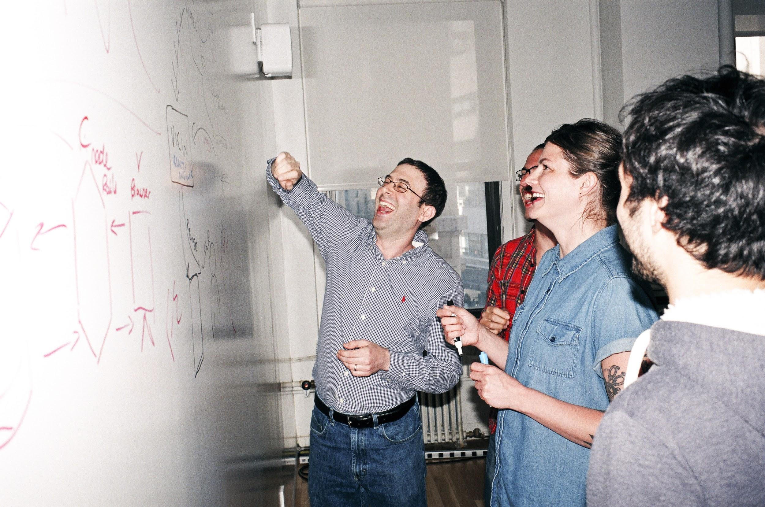

Welcome to General Assembly
WiFi GA Guest
Password yellowpencil
Notes:
[Leave this slide visible until presentation starts]

Slide 2
DATA SCIENCE
DAT10SYD
Week 3 - Model Evaluation

Slide 3
Course Plan
Paul & James review final project ideas

Slide 4
Git & GitHub – 1 Pager Guide!

Slide 5
AGENDA
Recap from last time
Evaluating machine learning models
Why is this important?
Correctly assessing the accuracy of a model
Lab
Review

Slide 6
RECAP: Last Lesson
DATA SCIENCE PART TIME COURSE

Slide 7
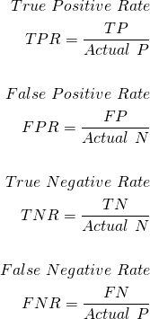
Accuracy of a Classification Model
Actual
“Precision”
Prediction
“Recall”
“True positive rate”
“True negative rate”

Slide 8
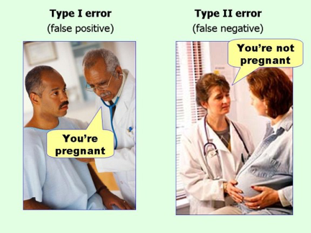
CONFUSION MATRIX

Slide 9
PRECISION & RECALL
Precision :
of those we guessed were positive, how often were we right?
Recall = Sensitivity :
how many of actual positives did we capture?
F1 measure :
balance of Precision and Recall

Slide 10
THE POINT OF EVALUATING MODELS
DATA SCIENCE PART TIME COURSE

Slide 11
EVALUATING MODELS
Why do we need to evaluate models?
Why might we need to be rigorous in evaluating models?

Slide 12
ESSENTIALS OF MODEL EVALUATION
DATA SCIENCE PART TIME COURSE

Slide 13
TRAINING ERROR
Q: What’s wrong with training error?

Slide 14
TRAINING ERROR
Q: What’s wrong with training error?
A: Training error is not a good estimate of
accuracy beyond training data.

Slide 15
TRAINING ERROR
Q: How low can we push the training error if we can make the model arbitrarily complex. Effectively “memorizing” the entire training set ?

Slide 16
TRAINING ERROR
Q: How low can we push the training error if we can make the model arbitrarily complex. Effectively “memorizing” the entire training set ?
A: Down to zero!

Slide 17
TRAINING ERROR
Why this matters
The data that we are given for prediction won’t always be the end of the data we are interested in! We may not have access to all the data of interest
We will gather data and build and iterate over models however a main reason for building the model was to predict unseen test cases.

Slide 18
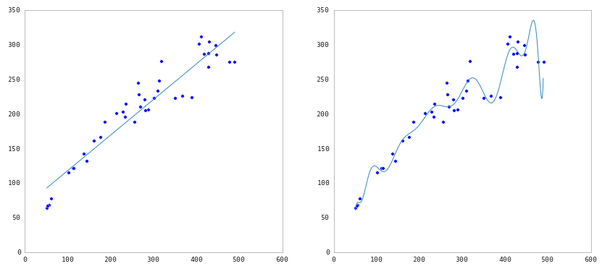
TRAINING ERROR

Slide 19
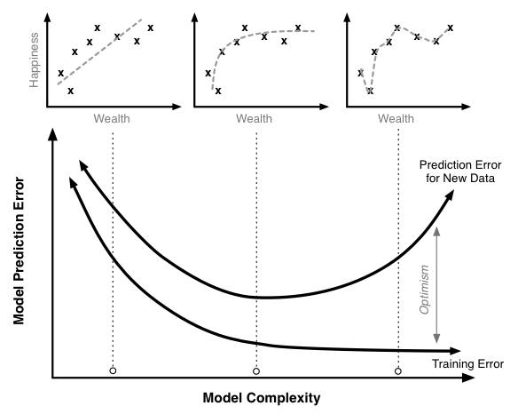
TEST vs TRAIN

Slide 20

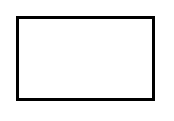
TEST SET APPROACH
Q: How can we make a model that generalises well?
model
In-sample dataset

Slide 21
TEST SET APPROACH
Q: How can we make a model that generalises well?
1) split dataset
model
In-sample dataset

Slide 22

TEST SET APPROACH
Q: How can we make a model that generalizes well?
1) split dataset
2) train model
training set
model
In-sample dataset

Slide 23

TEST SET APPROACH
Q: How can we make a model that generalizes well?
1) split dataset
2) train model
3) test model
training set
model
test set
In-sample dataset

Slide 24
TEST SET APPROACH
Q: How can we make a model that generalizes well?
1) split dataset
2) train model
3) test model
4) parameter tuning
training set
model
test set
In-sample dataset

Slide 25
TEST SET APPROACH
Q: How can we make a model that generalizes well?
1) split dataset
2) train model
3) test model
4) parameter tuning
5) choose best model
training set
model
test set
In-sample dataset

Slide 26
TEST SET APPROACH
Q: How can we make a model that generalizes well?
1) split dataset
2) train model
3) test model
4) parameter tuning
5) choose best model
6) train on all data
training set
model
test set
In-sample dataset

Slide 27

TEST SET APPROACH
Q: How can we make a model that generalizes well?
1) split dataset
2) train model
3) test model
4) parameter tuning
5) choose best model
6) train on all data
7) test predictions
on OOS data
training set
model
test set
Out of Sample
(OOS)
Not used to train model
In-sample dataset

Slide 28
TEST SET APPROACH
Q: How can we make a model that generalizes well?
1) split dataset
2) train model
3) test model
4) parameter tuning
5) choose best model
6) train on all data
7) test predictions
on OOS data
8) Apply model: create labels for new data
training set
Not labelled!
new
data
model
test set
Out of Sample
(OOS)
Not used to train model
In-sample dataset

Slide 29
LAB1
DATA SCIENCE PART TIME COURSE

Slide 30
Git & GitHub – 1 Pager Guide!

Slide 31
TEST SET APPROACH
Suppose we do the train/test split.
Q: How well does test set error predict Out of Sample Error?

Slide 32
TEST SET APPROACH
Suppose we do the train/test split.
Q: How well does test set error predict Out of Sample Error?
A: On its own, not very well.

Slide 33
TEST SET APPROACH
Suppose we do the train/test split.
Q: How well does test set error predict Out of Sample Error?
A: On its own, not very well.
Thought experiment:
Suppose we had done a different train/test split.
Q: Would the test set error remain the same?

Slide 34

TEST SET APPROACH
Suppose we do the train/test split.
Q: How well does test set error predict Out of Sample Error?
A: On its own, not very well.
Thought experiment:
Suppose we had done a different train/test split.
Q: Would the test set error remain the same?
A: Of course not!
NOTE
The test set error gives a high-variance estimate of OOS accuracy.

Slide 35
TEST SET APPROACH
Something is still missing!
Thought experiment:
Different train/test splits will give us different test set errors.
Q: What if we did a bunch of these and took the average?
A: Now you’re talking!
Cross-validation!

Slide 36
CROSS VALIDATION
DATA SCIENCE PART TIME COURSE

Slide 37
TEST SET APPROACH
Q: How can we make a model that generalizes well?
1) split dataset
2) train model
3) test model
4) parameter tuning
5) choose best model
6) train on all data
7) test predictions
on OOS data
8) Apply model: create labels for new data
training set
Not labelled!
new
data
model
test set
Out of Sample
(OOS)
Not used to train model
In-sample dataset

Slide 38

TEST SET APPROACH
Q: How can we make a model that generalizes well?
1) split dataset
2) train model
3) test model
4) parameter tuning
5) choose best model
6) train on all data
7) test predictions
on OOS data
8) Apply model: create labels for new data
Training sample
Test sample
Not labelled!
new
data
model
Out of Sample
(OOS)
Not used to train model
In-sample dataset

Slide 39
CROSS VALIDATION
Steps for K-fold cross-validation:
Randomly split the dataset into K equal partitions.
Use partition 1 as test set & union of other partitions as training set.
Calculate test set error.
Repeat steps 2-3 using a different partition as the test set at each iteration.
5) Take the average test set error as the estimate of OOS accuracy.

Slide 40
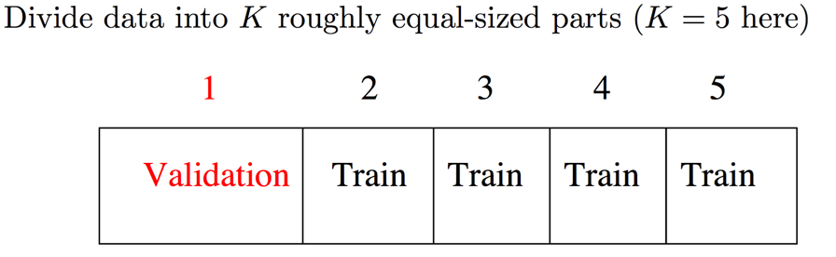
CROSS VALIDATION

Slide 41
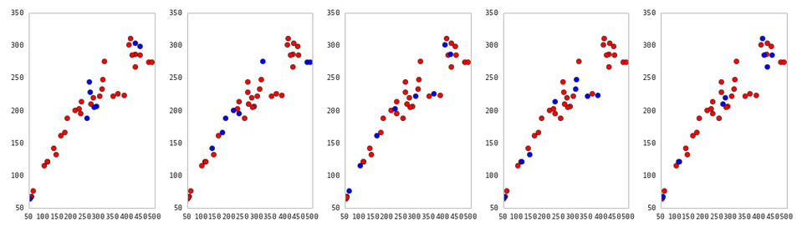
CROSS VALIDATION
5-fold cross-validation: red = training folds, blue = test fold
Source: http://nbviewer.ipython.org/github/fonnesbeck/Bios366/blob/master/notebooks/Section6_3-Model-Selection-and-Validation.ipynb

Slide 42
CROSS VALIDATION
Features of K-fold cross-validation:
More accurate estimate of OOS prediction error.
More efficient use of data than single train/test split. - Each record in our dataset is used for both training and testing.
Presents tradeoff between efficiency an computational expense. - 10-fold CV is 10x more expensive than a single train/test split
Can be used for parameter tuning and model selection.

Slide 43
BIAS & VARIANCE TRADEOFF
Training many models over many in-sample datasets will give different errors.
BIAS
This is how different the “averaged model” prediction is to the actual data
(High Bias = Large overall difference between best prediction and actuals)
VARIANCE
This is how variable different model predictions are for a given data point.
BIAS & VARIANCE
Together, these can tell us whether we are underfitting or overfitting

Slide 44
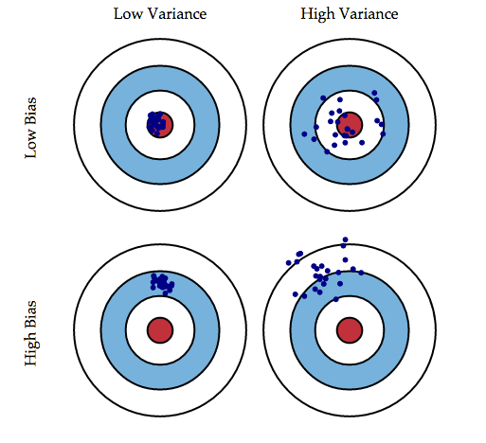
BIAS - VARIANCE TRADEOFF
44￼
Imagine 25 different models (of the same type) created using 25 different samples of the data
e.g: Predicting the yield of apples from trees (using the same features in each model, but different data samples)
These models are then used to predict 1 value,
e.g: comparing the yield for the same tree (as predicted in the 25 models)

Slide 45

BIAS - VARIANCE TRADEOFF

Slide 46
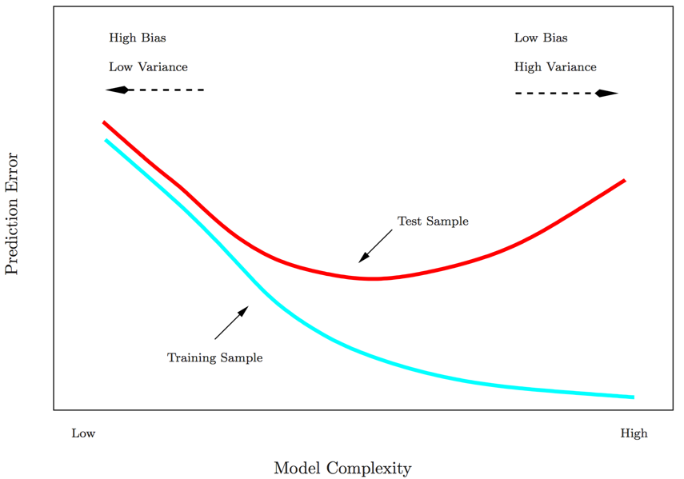
BIAS - VARIANCE TRADEOFF

Slide 47
LAB - Evaluation Metrics
DATA SCIENCE PART TIME COURSE

Slide 48
DATA SCIENCE PART TIME COURSE
DISCUSSION TIME
Questions from previous lesson?
What are we trying to do when we use Logistic Regression?
How would you evaluate a regression problem?

Slide 49
QUESTIONS
What are we trying to do when we use Logistic Regression?
Why use it instead of Linear Regression for classification?
Evaluating a logistic Regression model

Slide 50
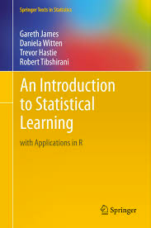
HOMEWORK
Pre-reading: An Introduction to Statistical Learning Chapter 6 - Model selection & regularisation
Caltech's Learning From Data course visualising bias and variance (15 mins)
http://work.caltech.edu/library/081.html
Rahul Patwari has a great video on ROC Curves (12 minutes)
https://www.youtube.com/watch?v=21Igj5Pr6u4
Have a look at scikit-learn’s documentation on model evaluation
http://scikit-learn.org/stable/modules/model_evaluation.html
DATA SCIENCE

